Slide 1
Webinar 3: Know Your Customers
Understanding the “buying” decision

Slide 2
Topics
Why is this important?
Who is your customer now?
Why do they “buy” from you? What is the perceived value?
The USP…
Could this value be delivered in other ways? = resilience
Who could they be in the future?
Thought for next time

Slide 3
Do you know why audiences engage with/customers buy from you?
As opposed to anyone else?
That knowledge opens up new markets for you and potential business growth.

Slide 4
Customer Insight
Who engages with you now?
Demographic characteristics
Interests
Etc

Slide 5
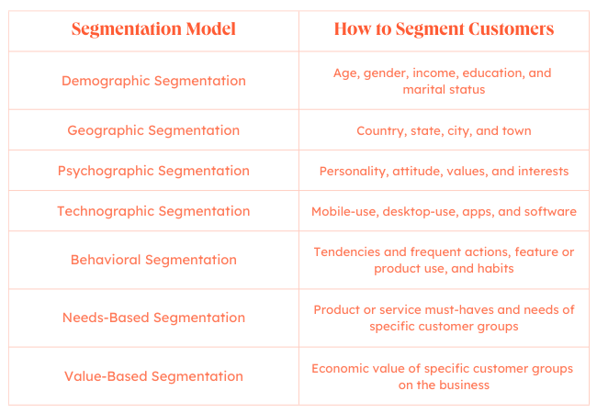

Slide 6
£?

Slide 7
Perceived Value?
If you know who you customer is, do you know the value you deliver to them?
(Tourist, pester power, enthusiast, in need)
Sentiment analysis, “what three words” association, surveys, peer analysis.
Is value aligned to £?

Slide 8
USP
the one thing that makes your business better than the competition
I have doubts…

Slide 9
Diversification
You know your customers
You know what they value
So can you meet this need in another way?
Brand extension!

Slide 10
Future customers
No such thing as steady state…
TAM – total addressable market
SAM – served addressable market
Target – your precisely defined market

Slide 11
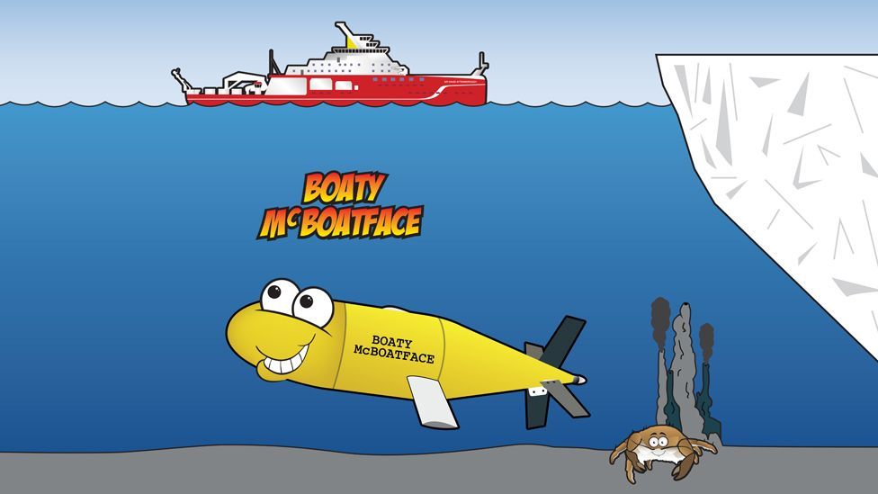
Final thought…

Slide 12
Catherine.johns@wearecreative.uk

