Slide 1
Webinar 5:
Making the Case
Putting it all together

Slide 2
Topics
Where are we in the journey?
Making the case for investment – the business plan for growth
Final thought

Slide 3
The journey:
Your core purpose – how can that be flexed and delivered?
External analysis – what is the landscape in which you operate?
Customer understanding – who else could want what you have?
Internal analysis – how are you best placed to make the most of market opportunities and grow the business?
Putting it all together into a case for investment

Slide 4
The business plan…
Short, concise, evidence-based
20 pages plus appendices
Answers to the key questions:
Who are you and what do you do?
What is your competitive advantage – external and internal analysis
How will you make money from what you do?
How will you get there?
What do you need from “me”, i.e., the investor? What’s the ask?
(Handy tip – the Executive Summary of the business plan is a one pager answering these questions).
= strategic choice.
Internal analysis needed!

Slide 5
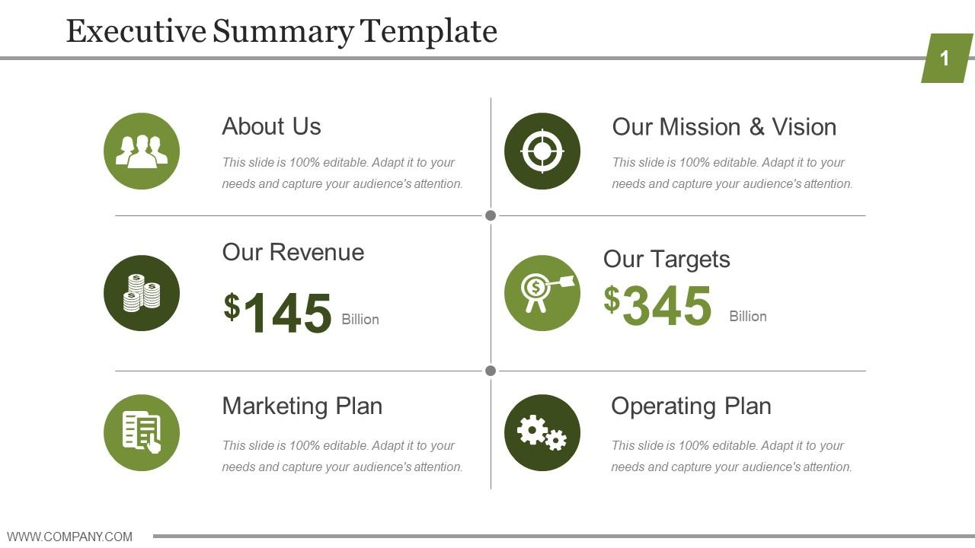
What should a business plan cover? Section 1
Executive Summary: one page answering the key questions - do this last…

Slide 6
What should a business plan cover? Section 2
Company overview:
Short description
Mission, vision, values, purpose, objectives
Business model and ownership/governance
Current systems to manage HR, data, IT, H&S etc.
Management team and skills strategy
Partners

Slide 7
What should a business plan cover? Section 3
The external and internal environment (the analysis):
Market need
Competitive landscape – Five Forces, PESTLE, SWOT etc
Market opportunities and potential – analysis of the target market
Internal environment – SWOT, VRIO, Theory of Change, BMC, etc.
Conclusions – a summary of where the business should go
(Handy hint – this is actually one of the most important sections; it shows any investor the evidence of need for what you do)

Slide 8
What should a business plan cover? Section 4
Delivery – the journey you need to go on to grow the business:
Operational Plan – staffing, etc
Financial Plan – P&L
Marketing Plan – how you will reach your customers
Success measures and targets – keep it short and relevant
Activity Plan summary
Risk Management summary

Slide 9
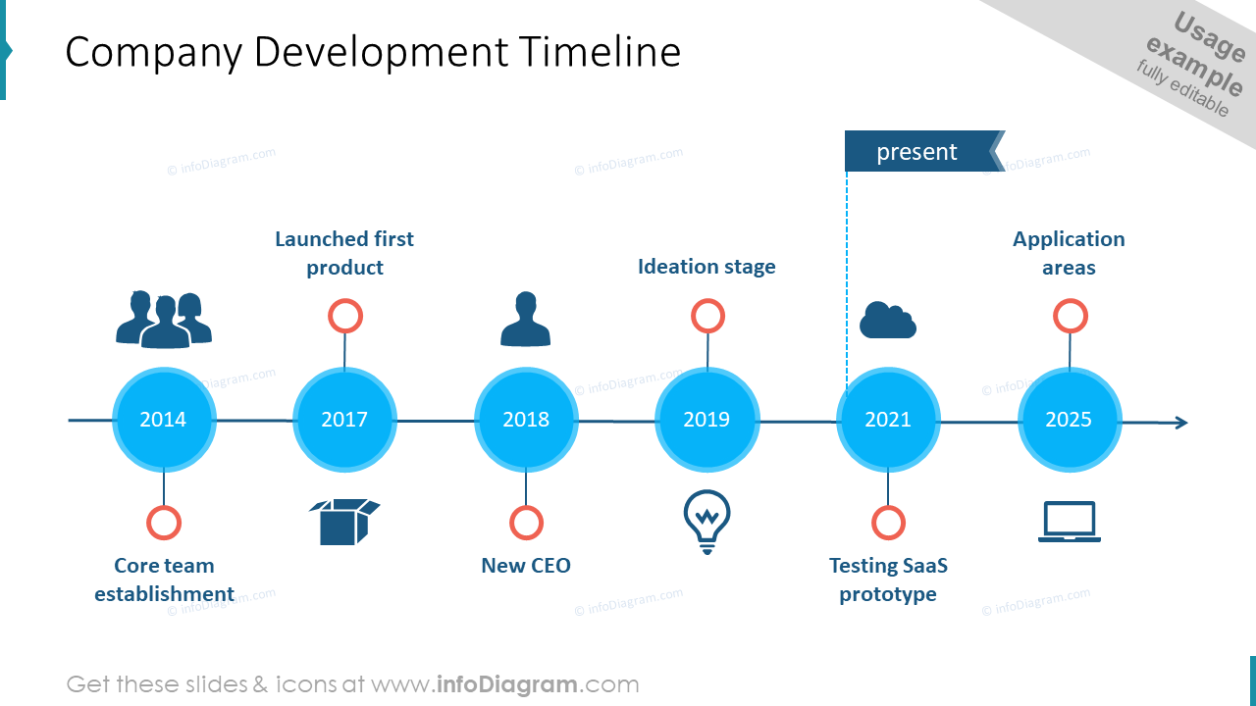
What should a business plan cover? Section 5
Optional Summary section – development and investment timeline

Slide 10
What should a business plan cover? Appendices
Full analyses
Financial tables
AOB…

Slide 11

Handy hint:

Slide 12

Final thought…

Slide 13
Final thought (another one)
It’s OK not to have all the answers.
A good investor will want to know that:
You understand the market and your potential
You understand where your company is
You know the questions to ask and the tasks to undertake on your growth journey
You know what you need from an investor to progress that journey – grant, loan and equity will have different rubrics but essentially this is the question to answer.

Slide 14
Catherine.johns@wearecreative.uk

