Slide 1
Embracing
Neurodiversity
in the Workplace

Slide 2
What is Autism?
Autism is a lifelong neurodevelopmental condition. Autistic people perceive and understand the world differently.
Every autistic person is different. Some autistic people are able to learn, live and work independently while many others require specialist support.
Around one million people in the UK are autistic. That is 1 in 67 people.

Slide 3
Autistic people experience some of the most stark inequalities in the UK

Slide 4
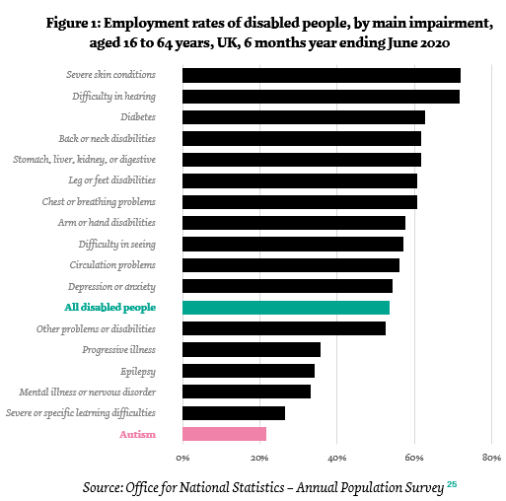
40x
more likely to die from epilepsy
16-25%
of children who died by suicide during the pandemic
One of the worst employment rates of any disabled group
16 years lower
average life expectancy
1 in 10 of people who die by suicide
79%
~1 in 5 of women/girls in eating disorder services
experience mental health problems
Notes:
Autistica (2019). Building Happier Healthier Longer Lives: Briefings to improve autism policy and research. autistica.org.uk/downloads/files/Building-Happier-Healthier-Longer-Lives-The-Autistica-Action-Briefings-2019.pdf
Autistica (2021). The Autistica Support Plan. autistica.org.uk/downloads/files/Autistica-Support-Plan.pdf
ONS (2021). Outcomes for disabled people in the UK: 2020. ons.gov.uk/peoplepopulationandcommunity/healthandsocialcare/disability/articles/outcomesfordisabledpeopleintheuk/2020#employment
NCMD (2021). Suicide in Children and Young People: National Child Mortality Database Programme Thematic Report. ncmd.info/wp-content/uploads/2021/11/NCMD-Suicide-in-Children-and-Young-People-Report.pdf & NCMD (2020). Child Suicide Rates during the COVID-19 Pandemic in England: Real-time Surveillance. ncmd.info/wp-content/uploads/2020/07/REF253-2020-NCMD-Summary-Report-on-Child-Suicide-July-2020.pdf

Slide 5
Our mission at Autistica
Autistica is the UK’s leading autism research and campaigning charity
Our mission is to create breakthroughs that enable autistic people to live happier, healthier, longer lives.

Slide 6
Autism and Games
According to the UKIE Games Industry Census 2022
The UK games industry has more neurodivergent people working within it than the working age population.
Overall, 18% of respondents reported having at least one neurodevelopmental condition.
Autistic people are also significantly less likely to be promoted – suggesting a requirement to consider autistic people’s needs in the games industry particularly.

Slide 7
Autistica Play
We know that autistic people are inspired to both make and play games.
We built the Autistica Play initiative to connect with the games industry to embrace inclusivity and make more of a difference for all autistic and neurodivergent people.

Slide 8
Autistica Play’s DARE Game
Why is it important to embrace neurodiversity in the workplace?
Play our DARE Game to find out: https://autistica.itch.io/raisethegame-with-dare

Slide 9
Why should your company
invest in embracing neurodiversity
in the workplace?
Notes:
WHY

Slide 10
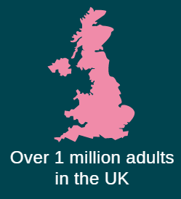
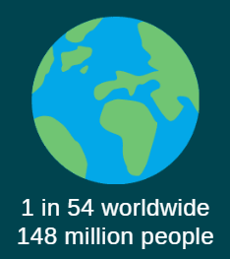
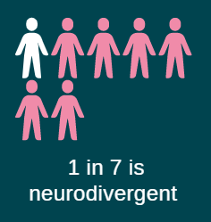
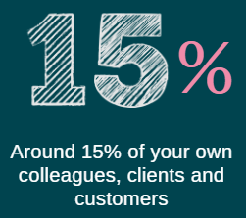
Neurodiversity refers to variations in the human brain and cognition, for instance in sociability, learning, attention, mood and other mental functions. It is also an umbrella term for conditions such as autism, ADHD, dyslexia, dyscacula etc.
Notes:
Teaser slide

Slide 11
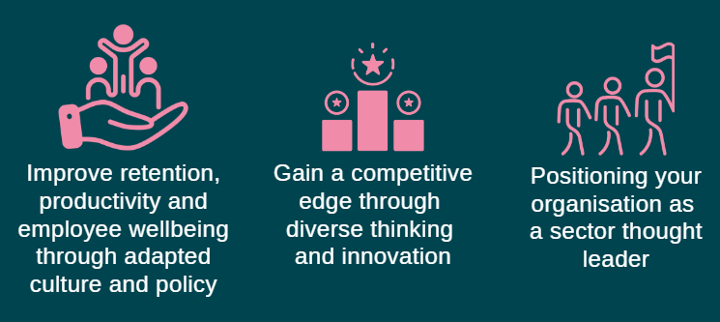
Notes:
Neurodiversity done well can generate ROI. And Autistica are uniquely positioned to help you do that

Slide 12
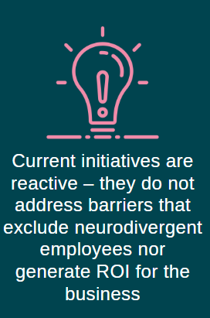
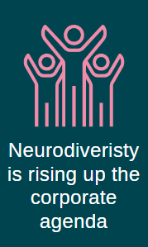
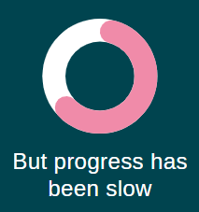
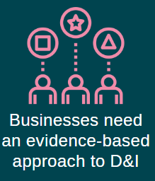
Notes:
Our USP – MAKE IT RELEVANT TO EMPLOYMENT
Although neurodiversity is becoming a top priority for many organizations, improvement initiatives are often not backed with enough evidence to drive progress, identify problems, strategize solutions. More often than not, this leads to, however well-meant, tokenistic and isolated efforts rather than system-wider and cultural change with sustainable impact.
As pressure continues to build around neurodiversity, businesses have a choice to make: be ahead of the curve, build the infrastructure that is needed to capitalise on the business opportunity neurodiversity brings, while addressing investors’ expectations on DEI, from disclosure to strategy and implementation. Or continue to make adaptations in isolation and play catch up later.

Slide 13
Autistica’s 2030 Goals
Goal 1
By 2030 all autistic people will have proven support from day one
Goal 2
By 2030 the employment rate for autistic people will double
Goal 3
By 2030 autistic people will have proven treatments for anxiety
Goal 4
Goal 5
Goal 6
By 2030 public spaces will be more accessible for neurodivergent people
By 2030 every autistic adult will be offered a yearly, tailored health check
By 2030 attitudes to autistic people will change
Notes:
Emphasis: these are not things that WE will do – we can’t achieve them on our own. They are visionary and ambitious goals that we know we can only achieve with help from others.

Slide 14
Goal 2
By 2030 the employment rate for autistic people will double
We know that...
Too many autistic people are deprived of meaningful, sustained employment.
So we should...
Make standard recruitment and working practices more accessible and develop specialist employment support that works for autistic people who need it.
Pillars
Career ready
Young autistic people will be empowered to compete for jobs they want
Finding the right job
Recruitment practices will give autistic applicants a fairer chance and employers a better choice of candidates
Lifelong support
Employers will have access to information and training to better support autistic people, who will in turn have access to quality employment support if and when they need it

Slide 15
The Employment Plan
We will double the employment rate for autistic people through the Autistica Employment Plan by establishing:
Support for autistic jobseekers
Support for employers
Notes:
How do we go from 2022 to 2030? Early this year, we released six visionary and ambitious goals, outlining how we will change the outcomes for autistic people by 2030 in 6 key areas of urgent need: post-diagnostic support, employment, proven treatments for anxiety, accessible and inclusive public spaces, annual tailored health checks, and changed attitudes without stigma towards autistic people.
As part of this plan, we have committed to doubling the employment rates for autistic people by 2030. Our Employment plan addresses both sides of the equation: autistic jobseekers and employers. Specifically, we will:
Support autistic job seekers through a series of programmes including: employment readiness, career support profiles, specialist work coaches, career progression
Provide employers with the resources, tools and solutions they need to implement neurodiversity strategies and accelerate efforts in this area: adapted recruitment practices, supported employment programmes, workplace adjustments toolkit, and neurodiversity index rating to benchmark your inclusion framework

Slide 16
Support for Employers
The Employment Plan draws upon seven years worth of data turned into actionable insights. A data-led approach allows you to:
Implement solutions and guide year on year progress to create a neurodiversity inclusion strategy
Minimise the risk of getting it wrong e.g., inadvertent employee harm and HR risks
Power quicker and more effective decisions based on evidence-based best practice
Drive sustainable and measurable impact
Provide investors with evidence of how you are recruiting, retaining and promoting diverse talent
Notes:
Our data-led approach allows you to gain insights and take target action – just as you would do with any other business challenge. Collecting and analysing data is just the first step, however, in a long process. Businesses must then use these insights to carve out a bespoke strategy and assess what is working well, and what needs to change

Slide 17
Retain and develop existing talent
Your challenge
You’re highly likely to already be employing neurodivergent employees
Your standard working practices are not optimised to help them thrive and maximise their potential
You’re missing out on existing talent within your workforce
This reduces innovation
High costs on lack of productivity and staff wellbeing
High staff turnover, lost intellectual capital and innovation

Slide 18
Retain and develop existing talent
Workplace Adjustments
Implement data-led practical solutions to support neurodivergent employees
Harness the strengths and support the needs of existing and new neurodivergent staff
Empower line managers, peers to support their colleagues and improve cross-team effectiveness
Empower neurodivergent employees to maximise their potential

Slide 19
Retain and develop existing talent
Adapted Practices and Business Governance
Implement data-led policies and procedures to build a neurodiverse and inclusive working culture
Support safe disclosure of neurodiversity and disability to minimise legal risks
Create neurodiverse and inclusive organisation culture
Create healthier workforces and improve team-wide wellbeing
Minimise staff turnover
Decrease low productivity costs

Slide 20
Retain and develop existing talent
How will it work?
We will provide your HR Teams with an Employment Toolkit
We will compile a list of alternative working practices, recruitment practice and workplace adjustments
We will provide guidance and recommendations based on your neurodiversity journey and company needs
We will support your organisation to identify key initiatives to continually be ahead of inclusive practice

Slide 21
The Employee Lifecycle
Your challenges
Improve diversity scoring
Address skills shortage
Retain existing talent
Our solutions
Neurodiversity Employer’s Index
Employment Readiness Programme
Career Support Profiles
Workplace Adjustments
Graduate Internship Scheme
Adapted Working Practices
Neurodiversity Business Strategy
Pre-employment
On-boarding
Recruitment
Career Progression
Retirement Planning

Slide 22
Please contact me at: alice.cooper@autistica.org.uk
to have a chat about how we can support you to embrace neurodiversity in the workplace

Slide 23
Notes:
Benefits and wins – feel good slide – CAN WE ADD MORE INFO?

